Slide 1
GIAS Geospatial Analysis with Python
Ricardo Lopes
lopesr@edgehill.ac.uk
THF10

Slide 2
Overall Goal
By the end of the session, you will be able to:
Use Python to load and process school location data from GIAS.
Generate an interactive map visualisation of schools using Folium or Plotly.
Extend the script to add address points, illustrating distance to nearby schools.

Slide 3
Introduction
What GIAS data is:
“Get Information About Schools”: open data from the UK government containing school details, including addresses and coordinates.
Real-world use case:
Workforce planning, catchment analysis, and accessibility.
Learning Outcomes:
Load and clean real-world CSV data.
Visualise it on an interactive map.
Add new data layers dynamically.
Notes:
Objective: Introduce context and learning outcomes

Slide 4
?
What could we learn by visualising schools and students home addresses together?
Notes:
How do investigators balance their need to solve a crime with our fundamental right to privacy?

Slide 5
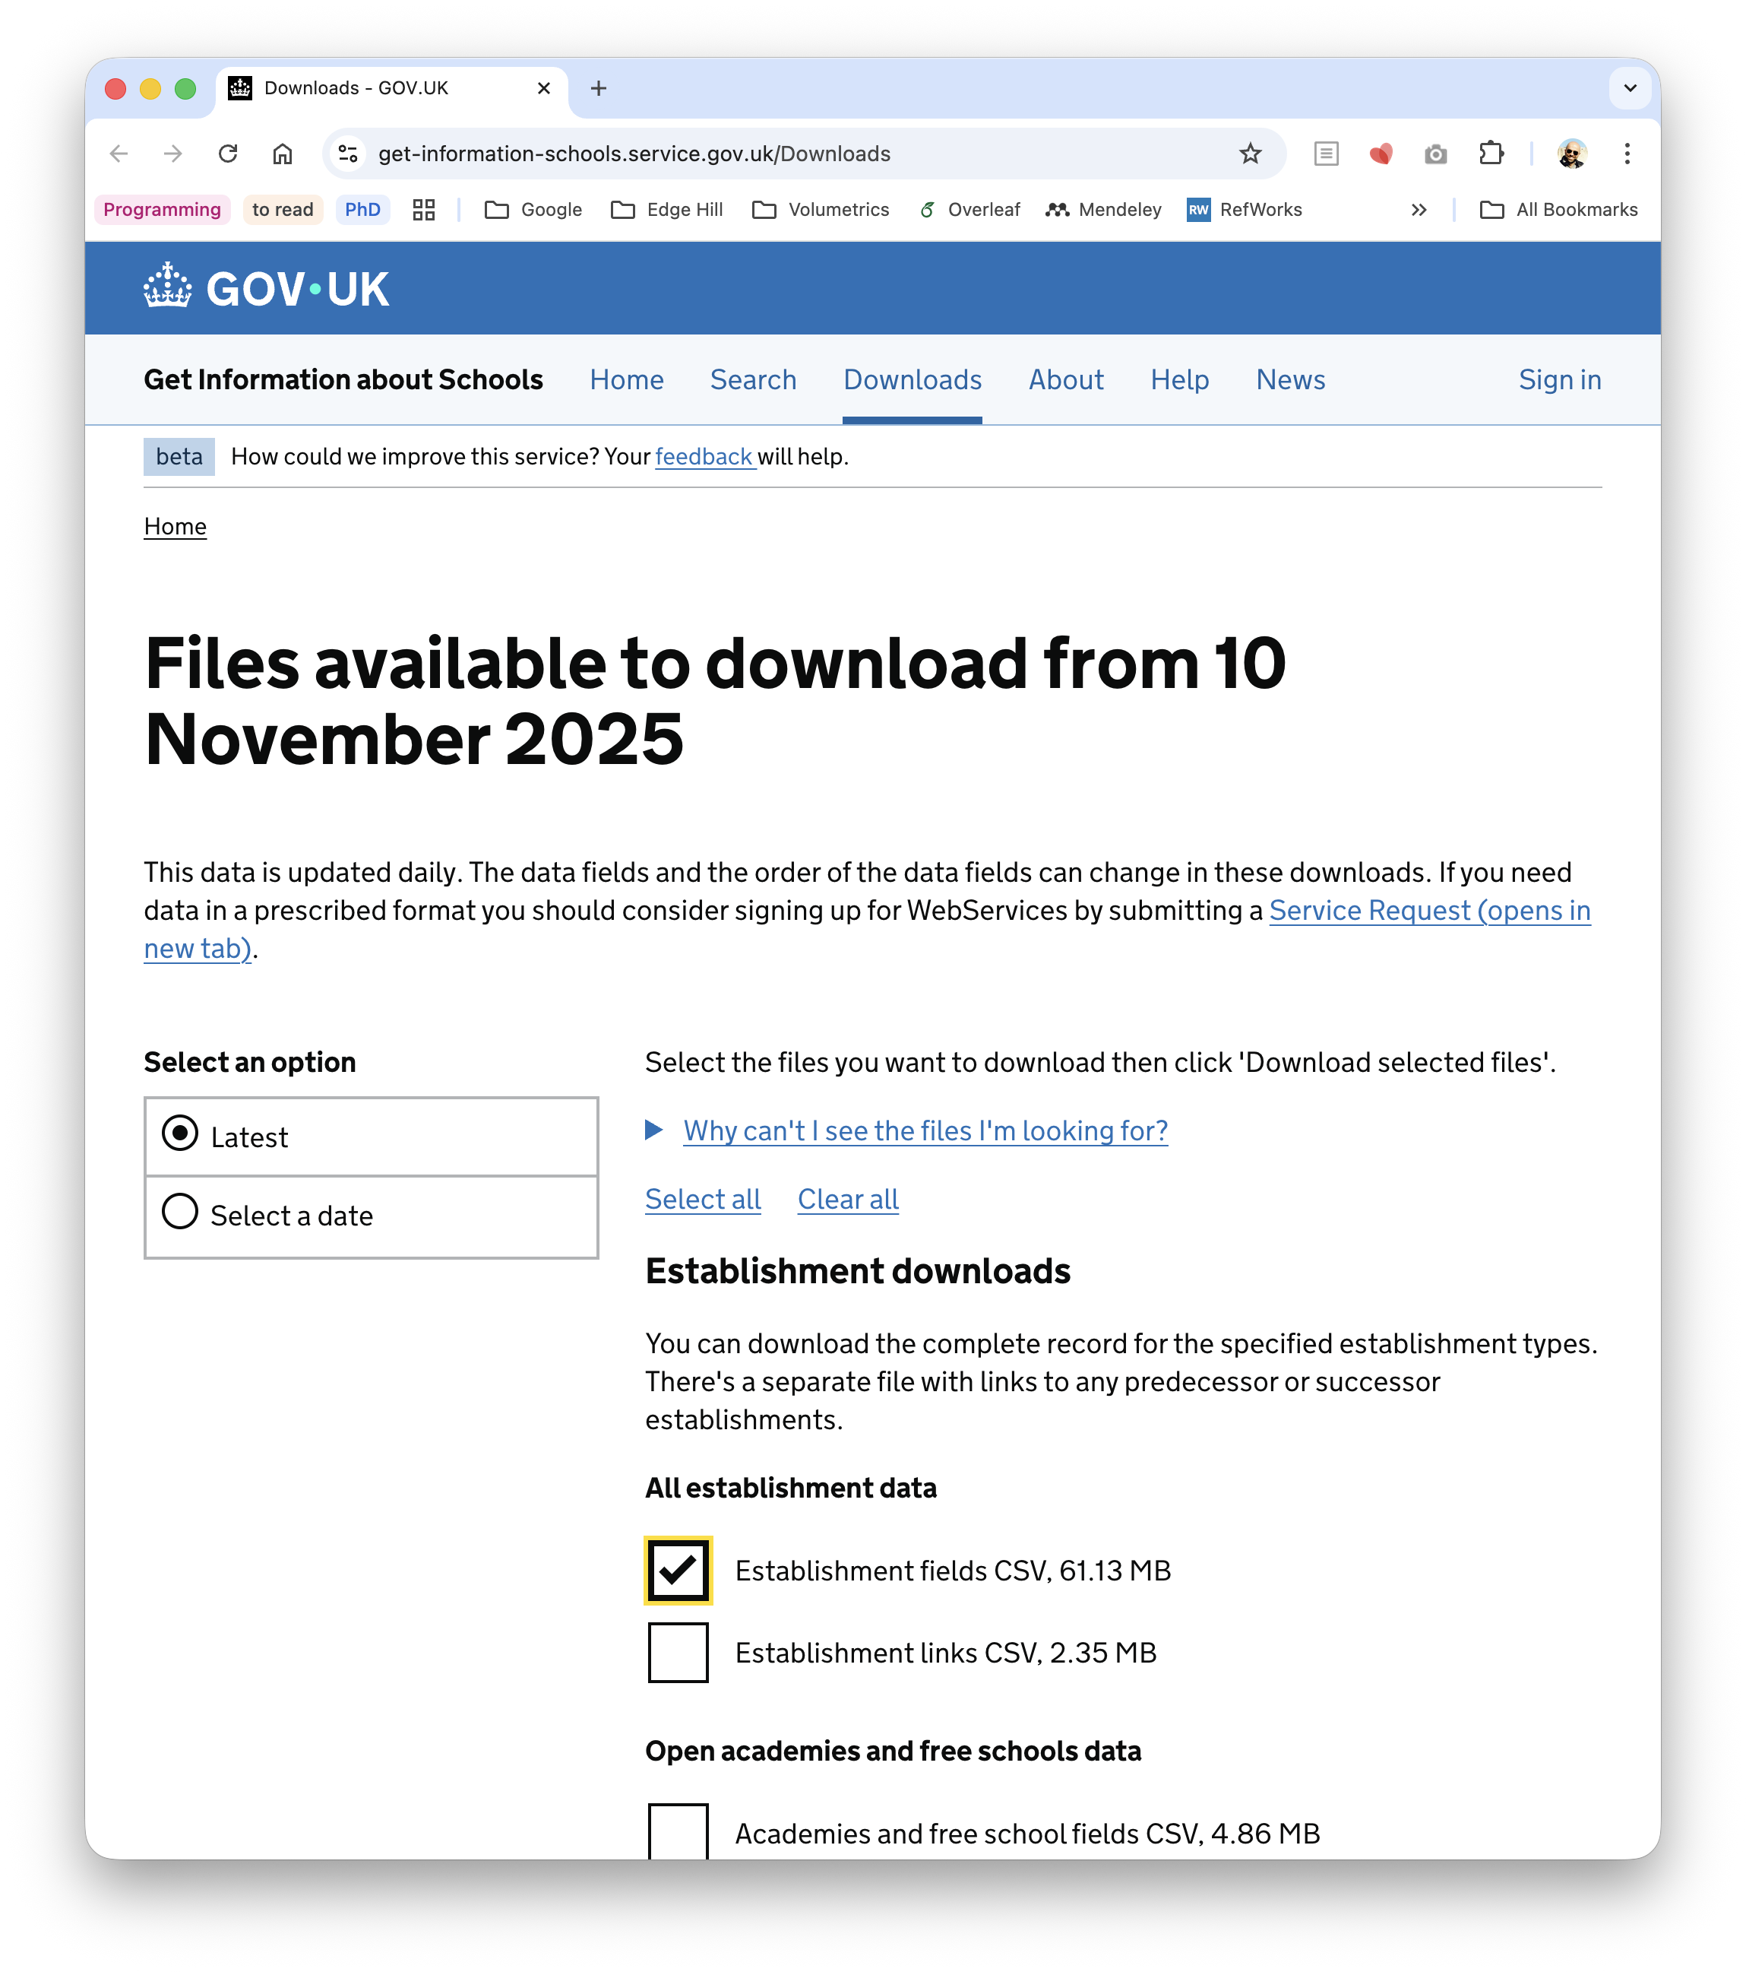
Getting and Exploring the Data
import pandas as pd # Load GIAS data gias = pd.read_csv("gias.csv", encoding="latin1") # Basic cleaning gias = gias[['EstablishmentName', 'Postcode', 'Easting', 'Northing']].dropna() print(gias.head())
DtypeWarning: Columns (48,50,51,69,70,93,124,129,134) have mixed types. Specify dtype option on import or set low_memory=False.
gias = pd.read_csv("gias.csv", encoding="latin1")
EstablishmentName Postcode Easting Northing
0 The Aldgate School EC3A 5DE 533498.0 181201.0
1 City of London School for Girls EC2Y 8BB 532301.0 181746.0
2 St Paul's Cathedral School EC4M 9AD 532160.0 181151.0
3 City of London School EC4V 3AL 531981.0 180844.0
4 Sherborne Nursery School NW5 4LP 528515.0 184869.0
Process finished with exit code 0
https://www.get-information-schools.service.gov.uk/Downloads
Notes:
Objective: Load and inspect the GIAS dataset

Slide 6
Getting and Exploring the Data
import pandas as pd # Load GIAS data gias = pd.read_csv("gias.csv", encoding="latin1", low_memory=False) # Basic cleaning gias = gias[['EstablishmentName', 'Postcode', 'Easting', 'Northing']].dropna() print(gias.head())
EstablishmentName Postcode Easting Northing
0 The Aldgate School EC3A 5DE 533498.0 181201.0
1 City of London School for Girls EC2Y 8BB 532301.0 181746.0
2 St Paul's Cathedral School EC4M 9AD 532160.0 181151.0
3 City of London School EC4V 3AL 531981.0 180844.0
4 Sherborne Nursery School NW5 4LP 528515.0 184869.0
Process finished with exit code 0
https://www.get-information-schools.service.gov.uk/Downloads
Notes:
Objective: Load and inspect the GIAS dataset

Slide 7
Getting and Exploring the Data
import pandas as pd # Load GIAS data gias = pd.read_csv("gias.csv", encoding="latin1", low_memory=False) # Basic cleaning gias = gias[['EstablishmentName', 'Postcode', 'Easting', 'Northing']].dropna() print(gias.info())
<class 'pandas.core.frame.DataFrame'>
Index: 50359 entries, 0 to 52103
Data columns (total 4 columns):
# Column Non-Null Count Dtype
--- ------ -------------- -----
0 EstablishmentName 50359 non-null object
1 Postcode 50359 non-null object
2 Easting 50359 non-null float64
3 Northing 50359 non-null float64
dtypes: float64(2), object(2)
memory usage: 1.9+ MB
None
Process finished with exit code 0
https://www.get-information-schools.service.gov.uk/Downloads
Notes:
Objective: Load and inspect the GIAS dataset

Slide 8
Converting Coordinates
The GIAS dataset includes Easting and Northing coordinates (British National Grid (BNG) coordinates), not latitude/longitude.
So, we will need to convert Easting and Northing → Latitude and Longitude before mapping.

Slide 9
Converting Coordinates
The GIAS dataset includes Easting and Northing coordinates (British National Grid (BNG) coordinates), not latitude/longitude.
So, we will need to convert Easting and Northing → Latitude and Longitude before mapping.
You can use pyproj (a geospatial projection library) to convert from OSGB36 (EPSG:27700) to WGS84 (EPSG:4326), which is used by Google Maps and Folium.
pip install pyproj

Slide 10
Converting Coordinates
The GIAS dataset includes Easting and Northing coordinates (British National Grid (BNG) coordinates), not latitude/longitude.
So, we will need to convert Easting and Northing → Latitude and Longitude before mapping.
You can use pyproj (a geospatial projection library) to convert from OSGB36 (EPSG:27700) to WGS84 (EPSG:4326), which is used by Google Maps and Folium.
pip install pyproj
from pyproj import Transformer # Create a transformer from British National Grid (EPSG:27700) to WGS84 (EPSG:4326) transformer = Transformer.from_crs("epsg:27700", "epsg:4326", always_xy=True) # Apply the transformation gias["Longitude"], gias["Latitude"] = transformer.transform( gias["Easting"].values, gias["Northing"].values )

Slide 11
Creating a Basic Interactive Map
import folium m = folium.Map(location=[53.55, -2.87], zoom_start=6) for _, row in gias.iterrows(): folium.CircleMarker( location=[row['Latitude'], row['Longitude']], radius=2, popup=row['EstablishmentName'], color='blue', fill=True, ).add_to(m) m.save("schools_map.html") print("Map created: schools_map.html")
Notes:
Objective: Introduce Folium and create a base map with school markers.

Slide 12
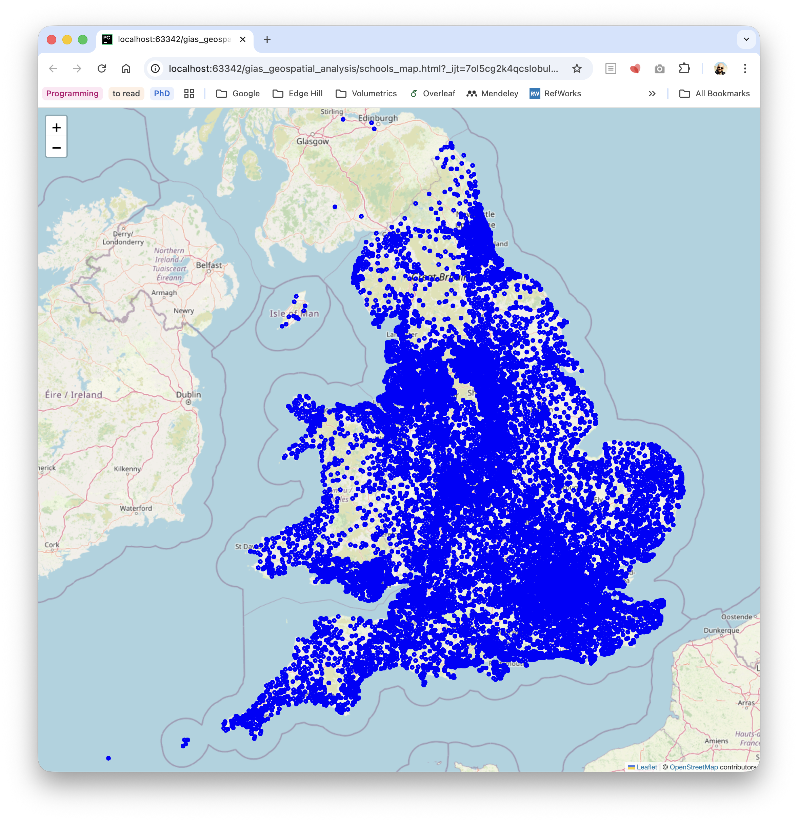
Creating a Basic Interactive Map
import folium m = folium.Map(location=[53.55, -2.87], zoom_start=6) for _, row in gias.iterrows(): folium.CircleMarker( location=[row['Latitude'], row['Longitude']], radius=2, popup=row['EstablishmentName'], color='blue', fill=True, ).add_to(m) m.save("schools_map.html") print("Map created: schools_map.html")
Notes:
Objective: Introduce Folium and create a base map with school markers.

Slide 13
Improving Data Analysis
import pandas as pd from pyproj import Transformer
import folium
# Load GIAS data gias = pd.read_csv("gias.csv", encoding="latin1", low_memory=False) # Basic cleaning gias = gias[['EstablishmentName', 'Postcode', 'Easting', 'Northing']].dropna() # Create a transformer from British National Grid (EPSG:27700) to WGS84 (EPSG:4326) transformer = Transformer.from_crs("epsg:27700", "epsg:4326", always_xy=True) # Apply the transformation gias["Longitude"], gias["Latitude"] = transformer.transform( gias["Easting"].values, gias["Northing"].values ) m = folium.Map(location=[53.55, -2.87], zoom_start=10)
for _, row in gias.iterrows(): folium.CircleMarker( location=[row['Latitude'], row['Longitude']], radius=2, popup=row['EstablishmentName'], color='blue', fill=True, ).add_to(m)
m.save("schools_map.html") print("Map created: schools_map.html")
colour_palette = ['#448AFF', '#1565C0', '#009688', '#8BC34A', '#FFC107', '#FF9800', '#F44336', '#AD1457']
def add_legend(map_object, title, items_dict, position='bottomleft'):
gias = gias[['EstablishmentName', 'Postcode', 'Easting', 'Northing', 'PhaseOfEducation (code)', 'PhaseOfEducation (name)']].dropna()
legend_items = {} for _, row in gias.iterrows(): phase_code = row['PhaseOfEducation (code)'] phase_name = row['PhaseOfEducation (name)'] folium.CircleMarker( location=[row['Latitude'], row['Longitude']], radius=2, popup=row['EstablishmentName'], color=colour_palette[phase_code], fill=True, ).add_to(m) legend_items[phase_name] = colour_palette[phase_code] add_legend(m, "School Types", legend_items)

Slide 14
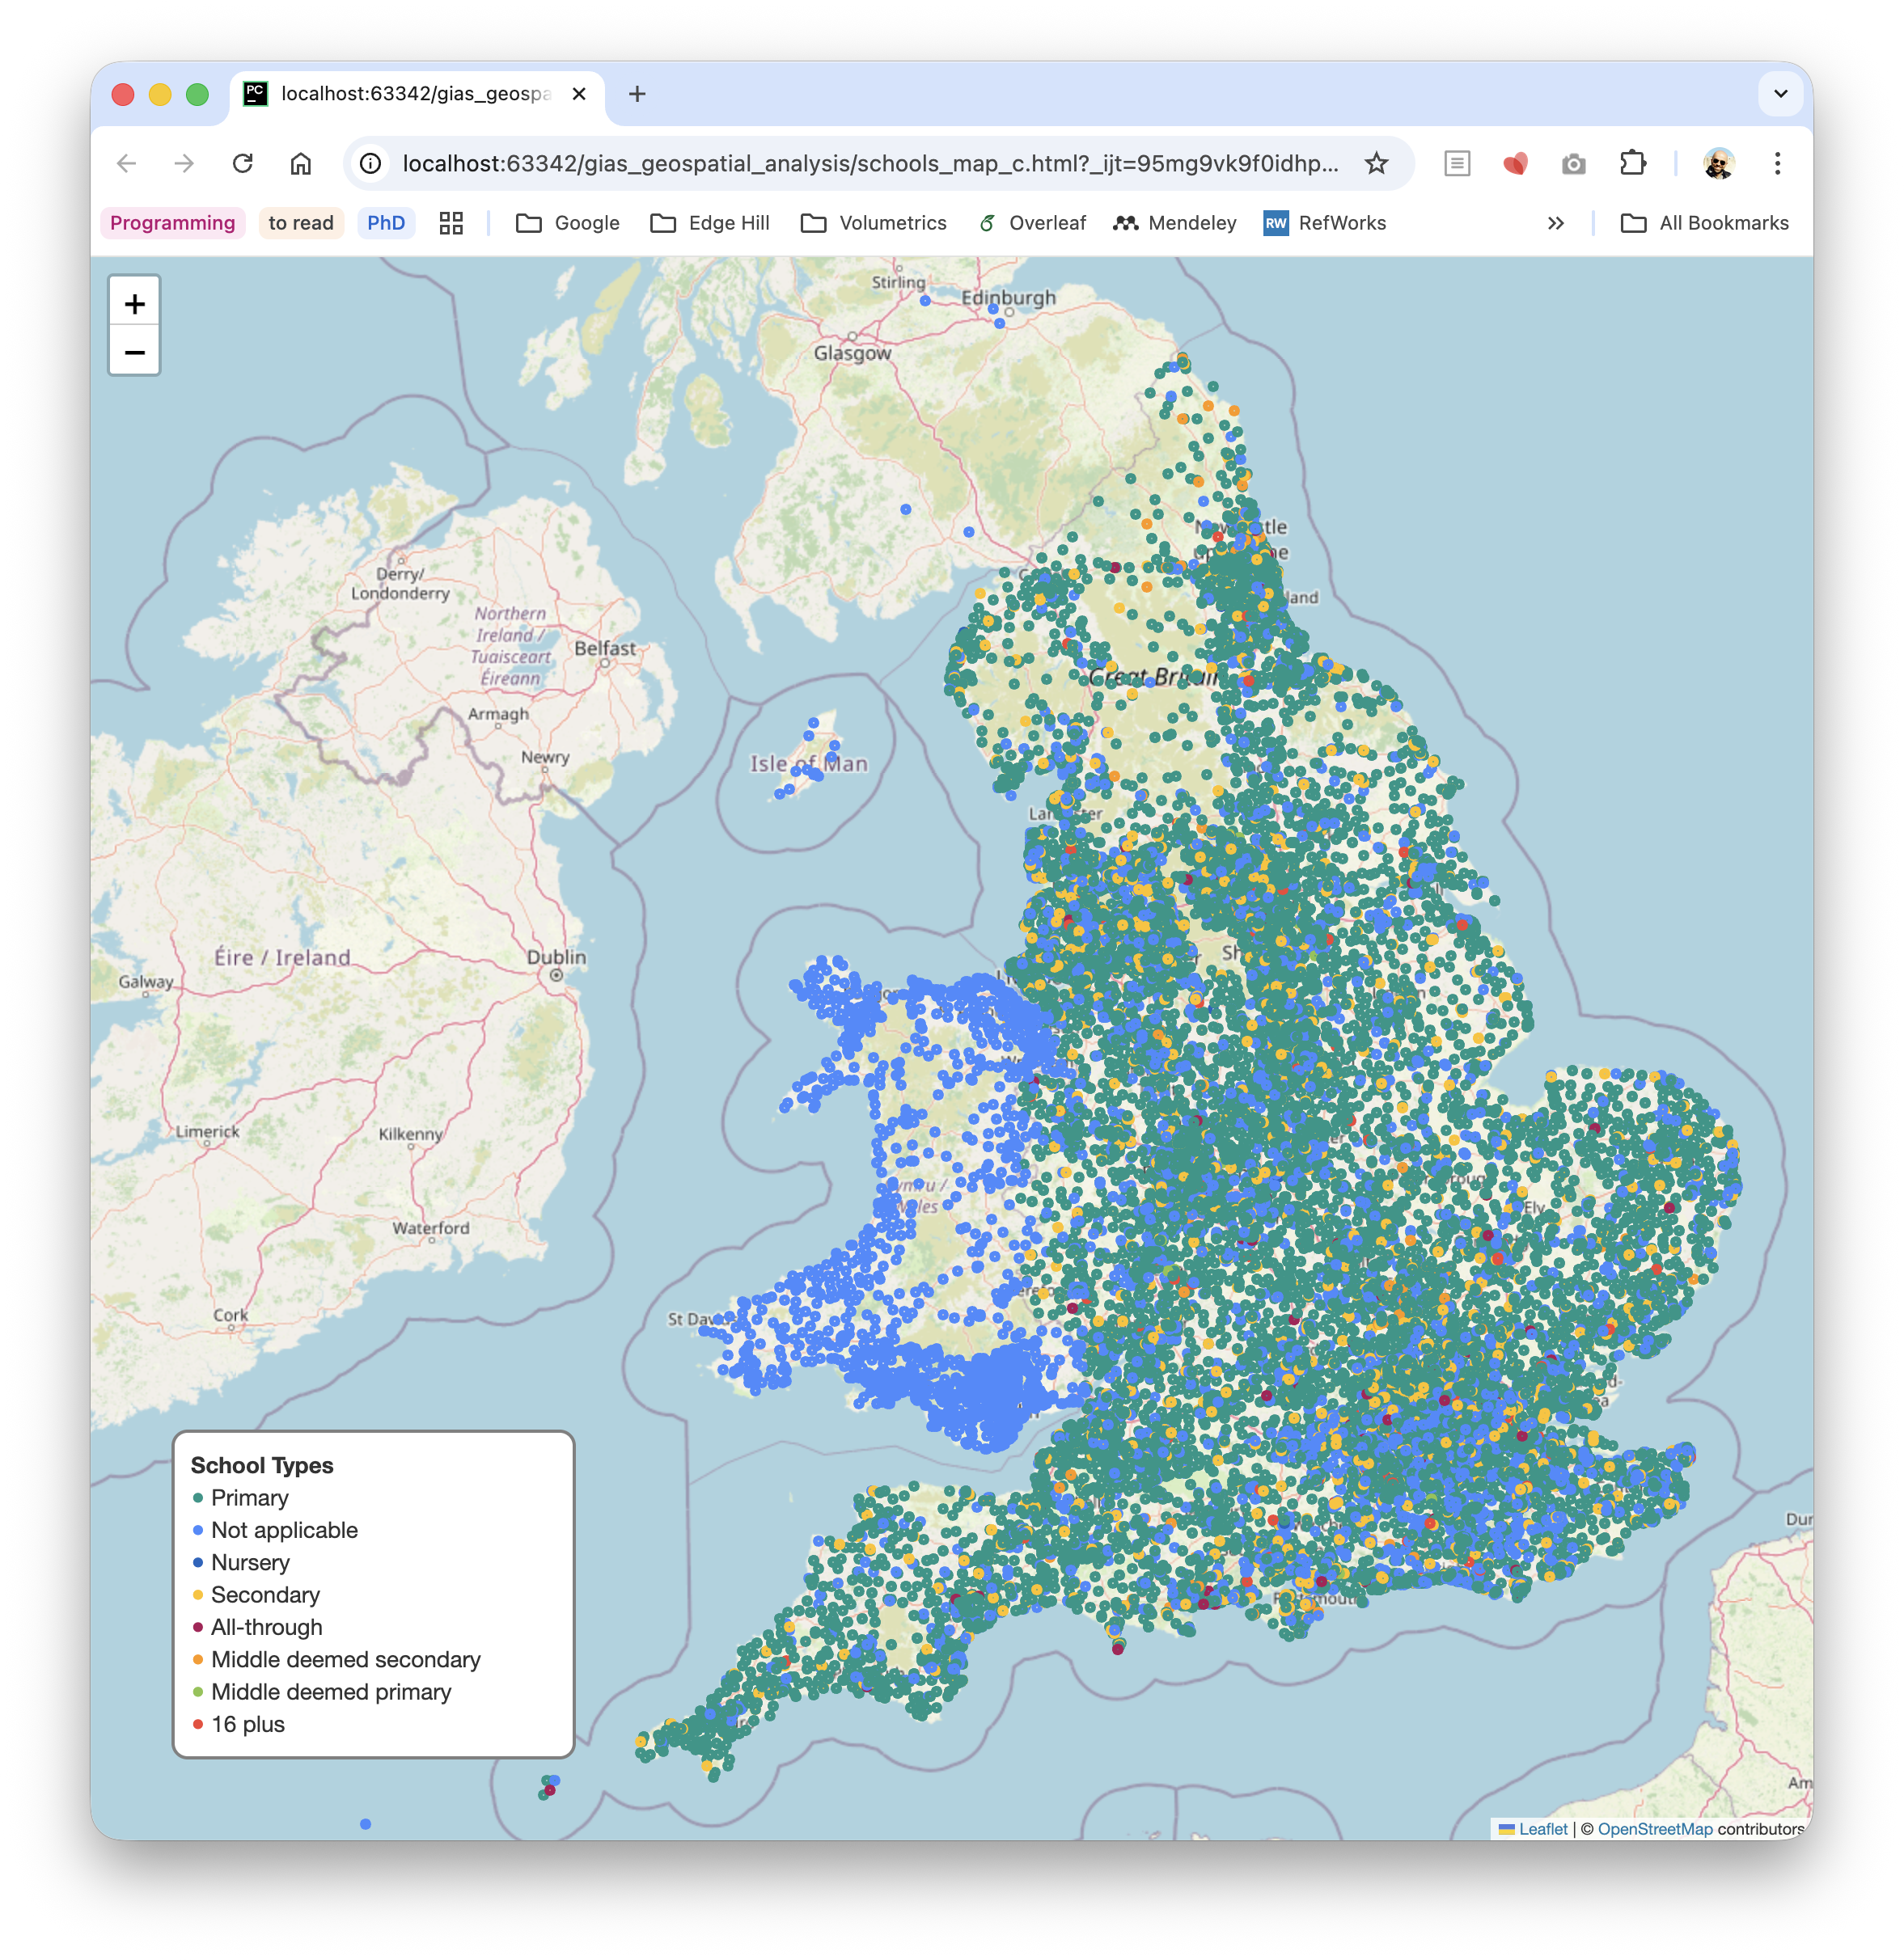
Improving Data Analysis
import pandas as pd from pyproj import Transformer
import folium
# Load GIAS data gias = pd.read_csv("gias.csv", encoding="latin1", low_memory=False) # Basic cleaning gias = gias[['EstablishmentName', 'Postcode', 'Easting', 'Northing']].dropna() # Create a transformer from British National Grid (EPSG:27700) to WGS84 (EPSG:4326) transformer = Transformer.from_crs("epsg:27700", "epsg:4326", always_xy=True) # Apply the transformation gias["Longitude"], gias["Latitude"] = transformer.transform( gias["Easting"].values, gias["Northing"].values ) m = folium.Map(location=[53.55, -2.87], zoom_start=10)
for _, row in gias.iterrows(): folium.CircleMarker( location=[row['Latitude'], row['Longitude']], radius=2, popup=row['EstablishmentName'], color='blue', fill=True, ).add_to(m)
m.save("schools_map.html") print("Map created: schools_map.html")
colour_palette = ['#448AFF', '#1565C0', '#009688', '#8BC34A', '#FFC107', '#FF9800', '#F44336', '#AD1457']
def add_legend(map_object, title, items_dict, position='bottomleft'):
gias = gias[['EstablishmentName', 'Postcode', 'Easting', 'Northing', 'PhaseOfEducation (code)', 'PhaseOfEducation (name)']].dropna()
legend_items = {} for _, row in gias.iterrows(): phase_code = row['PhaseOfEducation (code)'] phase_name = row['PhaseOfEducation (name)'] folium.CircleMarker( location=[row['Latitude'], row['Longitude']], radius=2, popup=row['EstablishmentName'], color=colour_palette[phase_code], fill=True, ).add_to(m) legend_items[phase_name] = colour_palette[phase_code] add_legend(m, "School Types", legend_items)

Slide 15
Improving Data Analysis
import pandas as pd from pyproj import Transformer
import folium
# Load GIAS data gias = pd.read_csv("gias.csv", encoding="latin1", low_memory=False) # Basic cleaning gias = gias[['EstablishmentName', 'Postcode', 'Easting', 'Northing']].dropna() # Create a transformer from British National Grid (EPSG:27700) to WGS84 (EPSG:4326) transformer = Transformer.from_crs("epsg:27700", "epsg:4326", always_xy=True) # Apply the transformation gias["Longitude"], gias["Latitude"] = transformer.transform( gias["Easting"].values, gias["Northing"].values ) m = folium.Map(location=[53.55, -2.87], zoom_start=10)
for _, row in gias.iterrows(): folium.CircleMarker( location=[row['Latitude'], row['Longitude']], radius=2, popup=row['EstablishmentName'], color='blue', fill=True, ).add_to(m)
m.save("schools_map.html") print("Map created: schools_map.html")
colour_palette = ['#448AFF', '#1565C0', '#009688', '#8BC34A', '#FFC107', '#FF9800', '#F44336', '#AD1457']
def add_legend(map_object, title, items_dict, position='bottomleft'):
gias = gias[['EstablishmentName', 'Postcode', 'Easting', 'Northing', 'PhaseOfEducation (code)', 'PhaseOfEducation (name)']].dropna()
legend_items = {} for _, row in gias.iterrows(): phase_code = row['PhaseOfEducation (code)'] phase_name = row['PhaseOfEducation (name)'] folium.CircleMarker( location=[row['Latitude'], row['Longitude']], radius=2, popup=row['EstablishmentName'], color=colour_palette[phase_code], fill=True, ).add_to(m) legend_items[phase_name] = colour_palette[phase_code] add_legend(m, "School Types", legend_items)

Slide 16
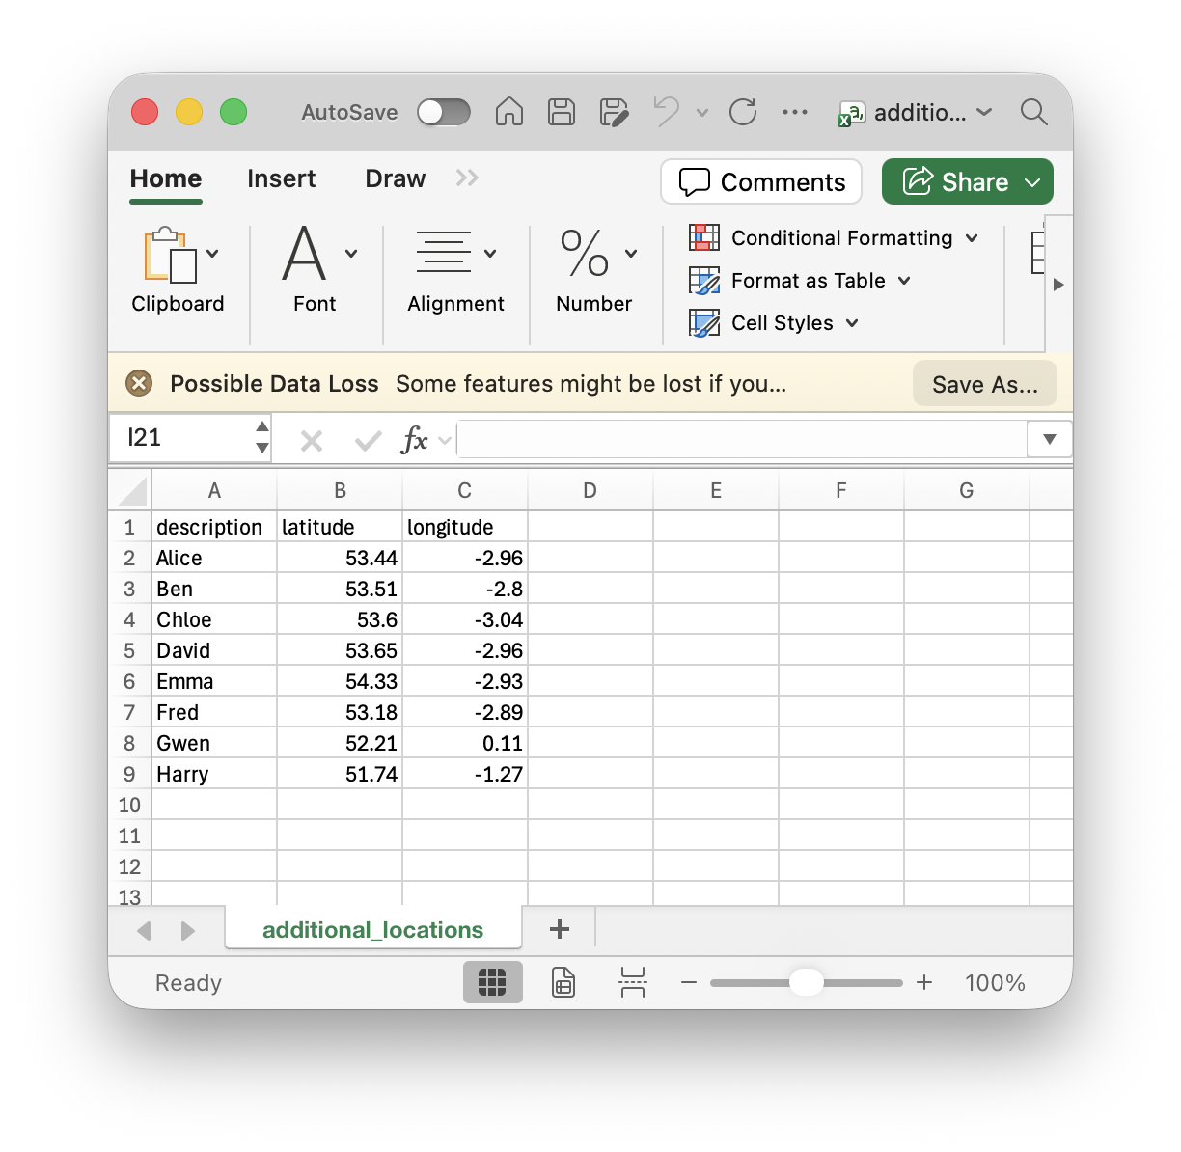
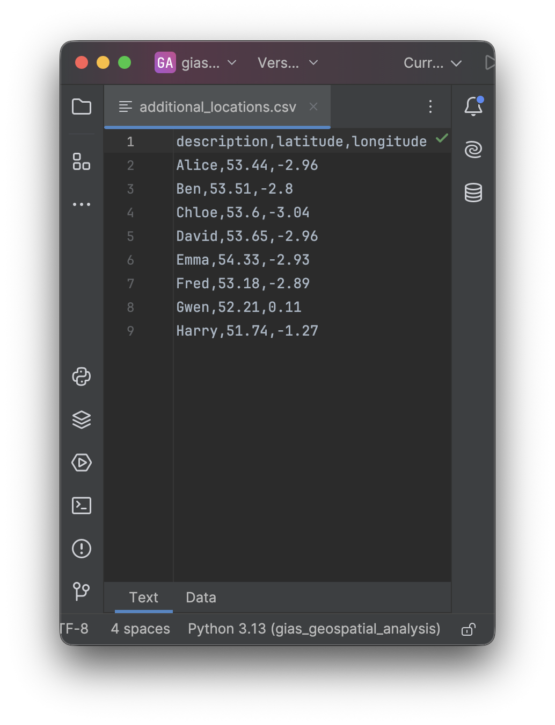
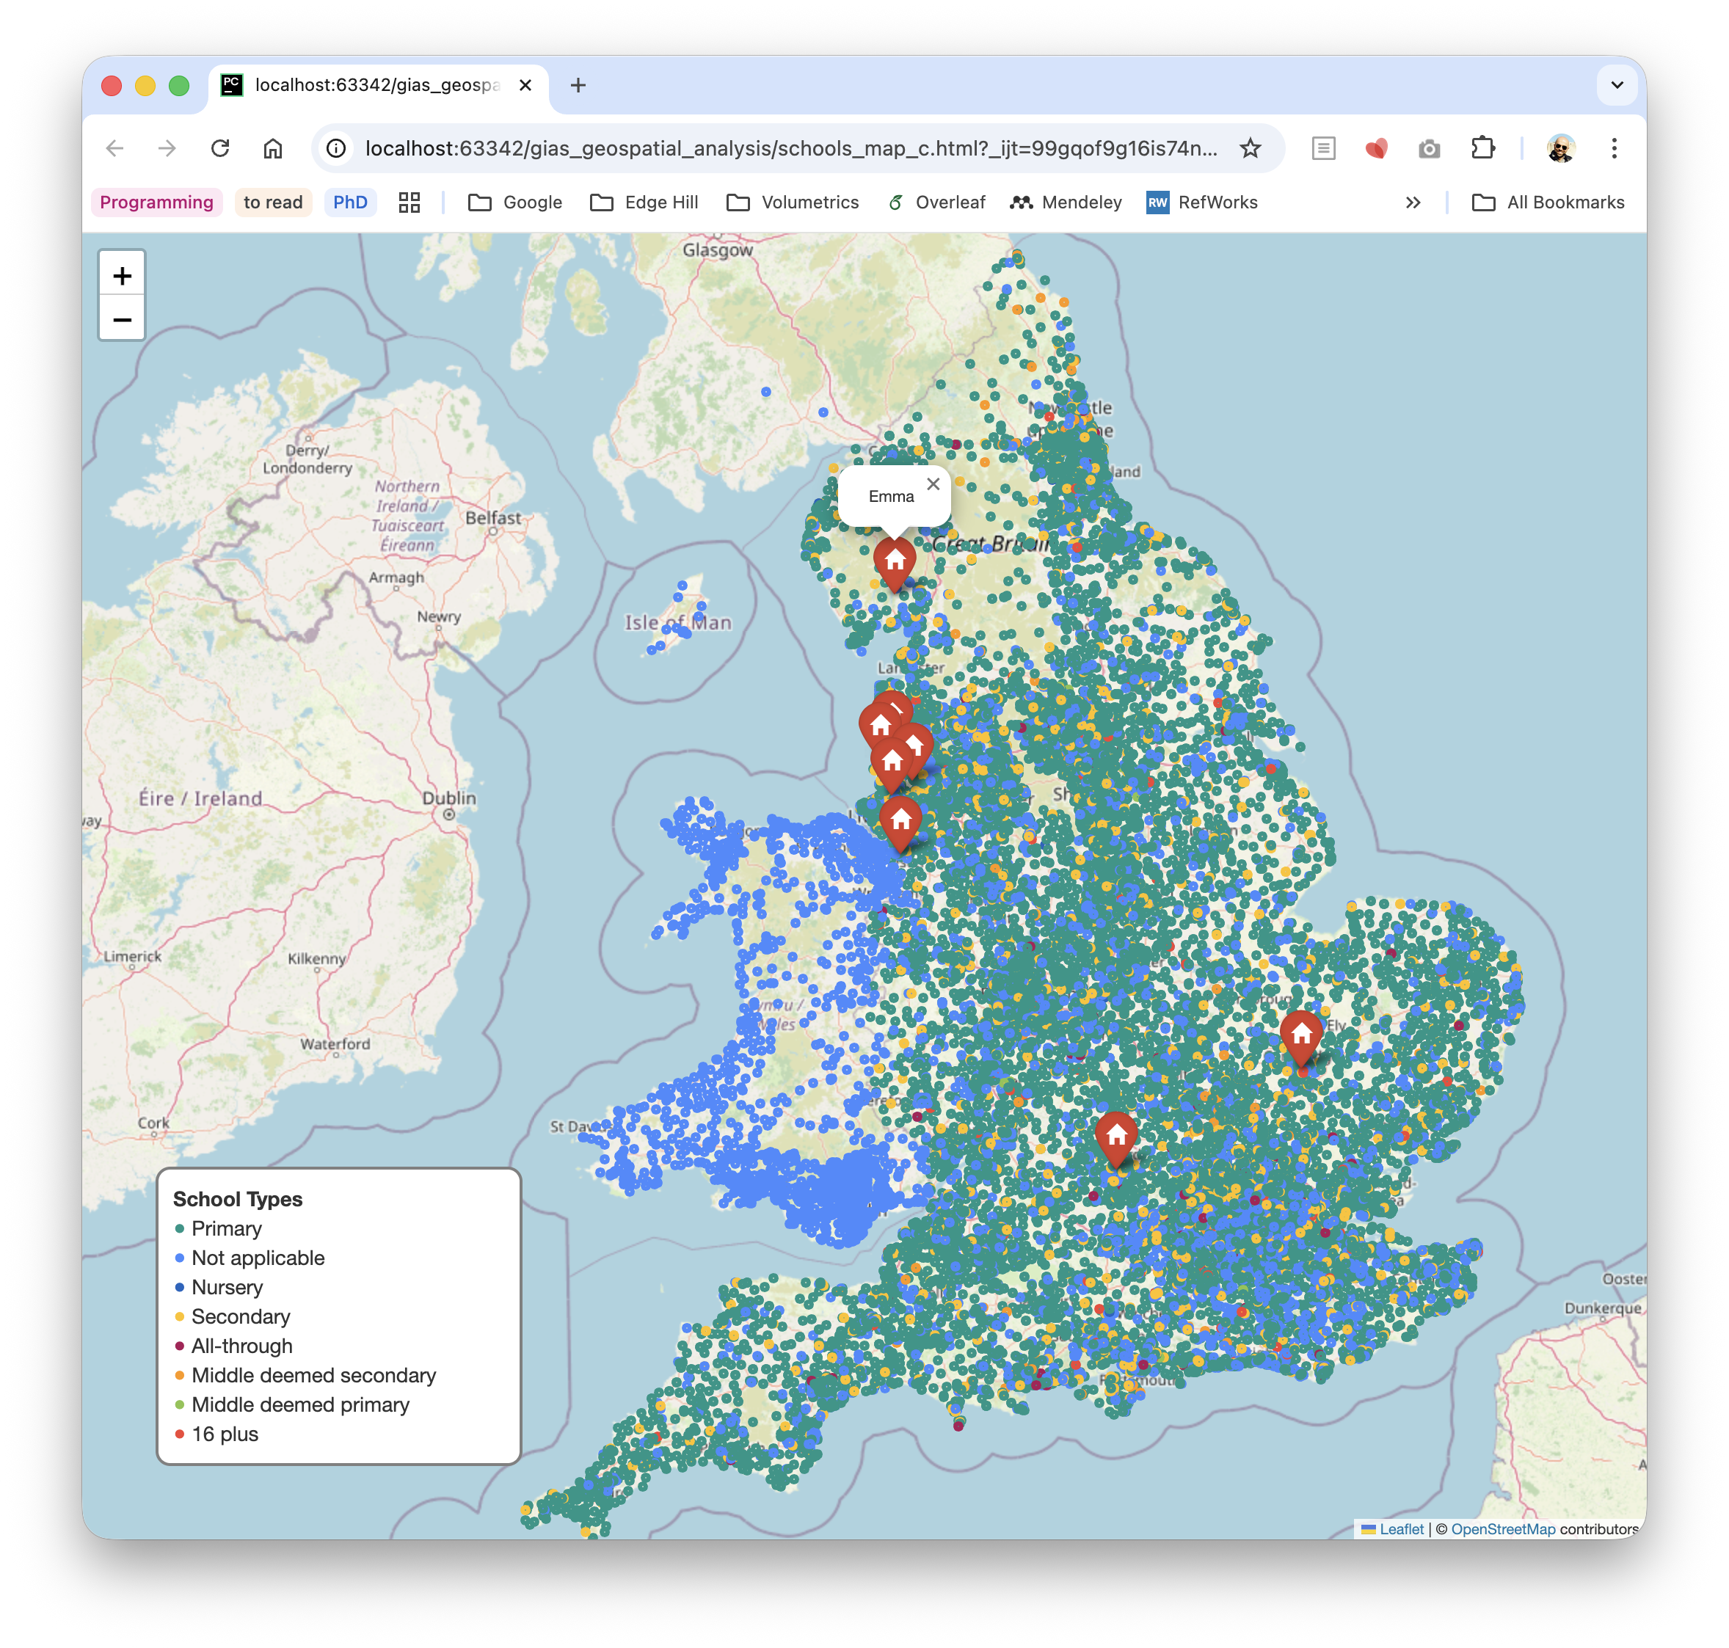
Plotting Additional Locations
additional_locations = pd.read_csv("additional_locations.csv")
for _, row in additional_locations.iterrows(): folium.Marker( location=[row["latitude"], row["longitude"]], popup=row["description"], icon=folium.Icon(color="red", icon="home") ).add_to(m)
Notes:
https://stackoverflow.com/questions/53721079/python-folium-icon-list

Slide 17



Thank You!
lopesr@edgehill.ac.uk
linkedin.com/in/rics23/

